Slide 1
Welcome To Zombie Runner

Slide 2
Zombie Runner
This is a First Person Shooter game with a Zombie theme. We implement Ray Casting to shoot, weapon switching with ammo pickups and more.

Slide 3
Zombie Runner Game Design

Slide 4
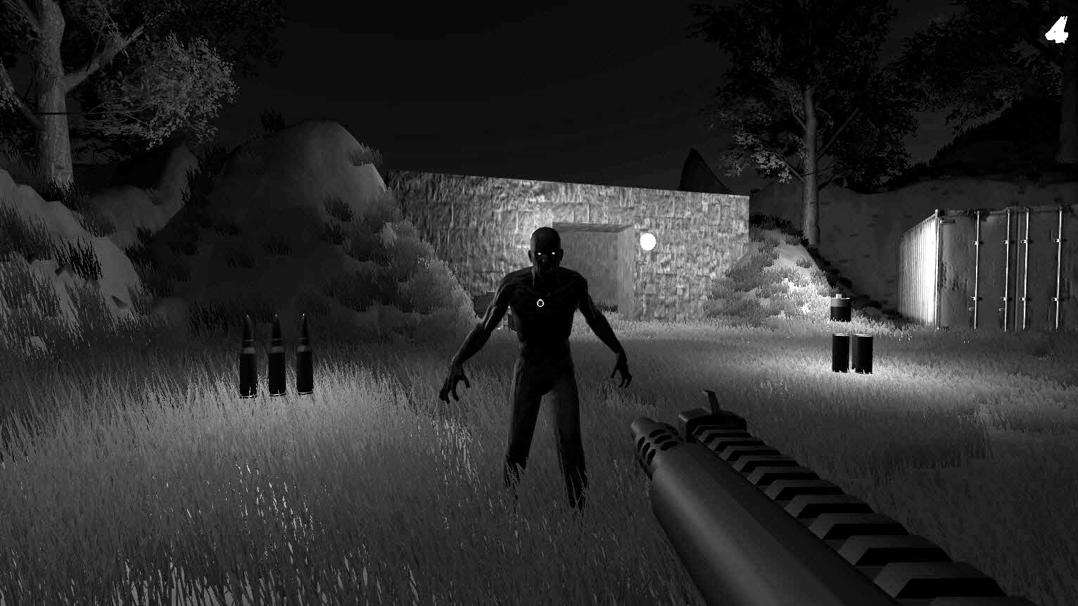
Core Gameplay Overview
Enemies that attack when provoked
Flashlight mechanic with recharging
Ammo count
Weapons we can cycle through
Ammo pickups

Slide 5
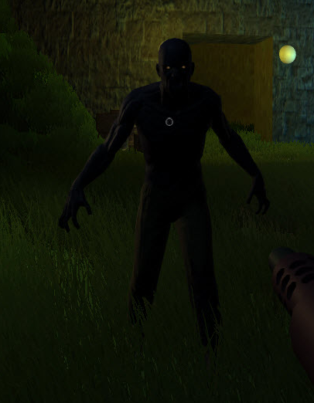
Game Design
Player Experience:
Intense
Core Mechanic:
Shoot enemies
Core game loop:
Collect ammo, shoot enemies, reach end of level

Slide 6
Game Theme
Dark. Forest and bunkers. Zombies.

Slide 7
MVP Features - In Order Of Priority
First Person Camera movement
Raycasting to shoot
Enemy move and attack AI
Health and damage system
Death / game over
Weapon switching
Ammo and ammo pickups
Flashlight and battery pickup
Probuilder geometry
Notes:
Minimum Viable Product (MVP) for a game includes only the core features necessary for it to be functional and playable, allowing for early testing and feedback.

Slide 8
What Theme Will You Implement?
I’m using zombies but you don’t have to
Browse the asset store for ideas
Enemy(s)
Weapon(s)
Props
Environment

Slide 9
Creating the Unity 6 project
After creating the new project
Delete the read me
Delete the Input System from the Assets folder because the assets directly from Unity Technologies that we’re about to download is going to come with its own Input Action map

Slide 10
Adding First Person Controller

Slide 11
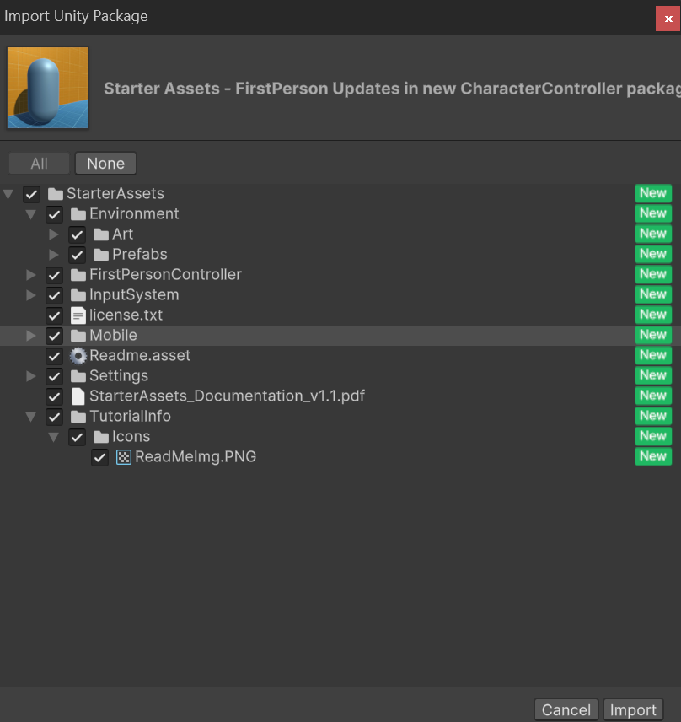
Import Standard Assets
Head over to the Unity Asset Store
https://assetstore.unity.com/packages/essentials/starter-assets-firstperson-updates-in-new-charactercontroller-pa-196525
Click on Add to my Assets, Open in Unity
Click on Download → Import
Install/Upgrade if you see a warning message
Click on Import
Notes:
It will give use First person controller that we can use to get us up and running

Slide 12
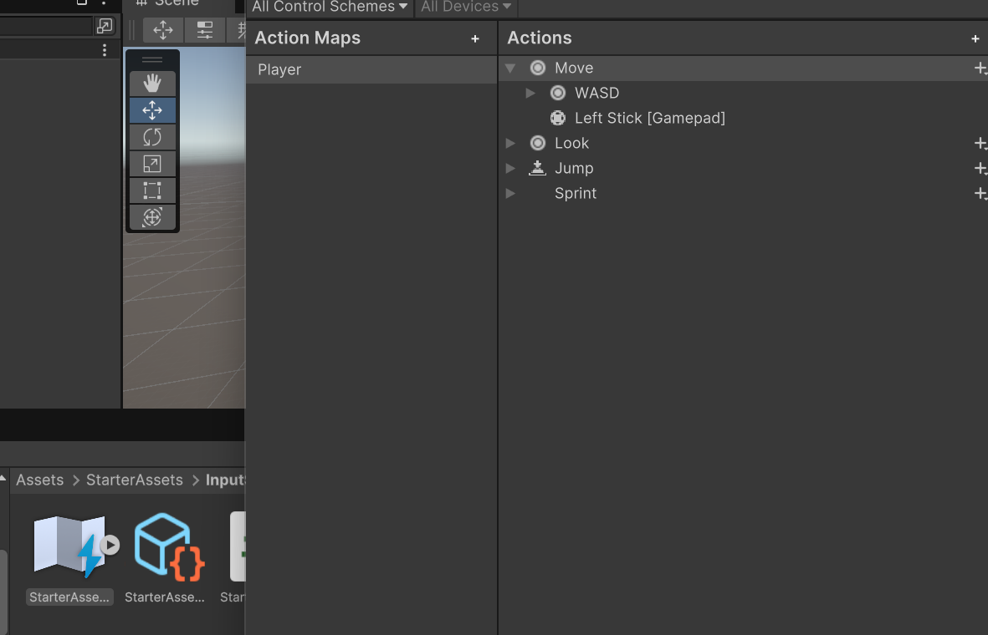
Import Standard Assets
Click on the Starter Assets- InputAction – Starter Asset

Slide 13
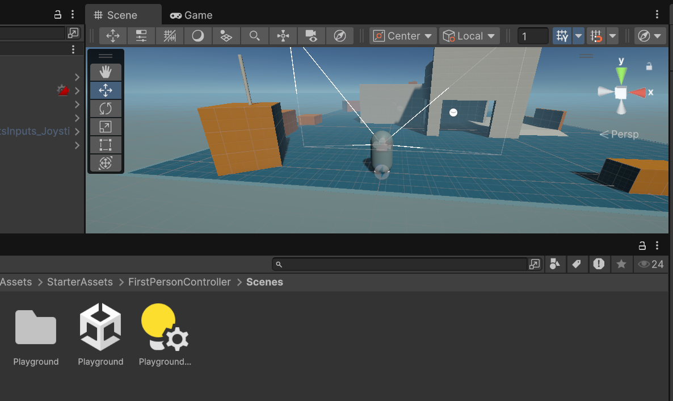
Import Standard Assets
Click on the Starter Assets- FirstPersonController – Scenes
Open the Playground
Inside the Hierarchy window – Click on the Player capsule and hit F
Click on Play and you can see the controls are working

Slide 14
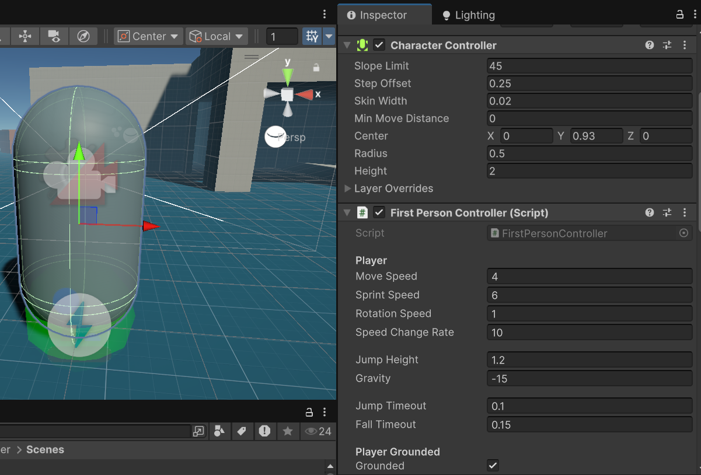
Import Standard Assets
In the inspector window you have Character Controller component
It actually just comes with any sort of unity project
You can attach this character controller component to any game object in any project.
Notes:
The Character Controller in Unity 6 (or Unity in general, as of Unity's later versions) is a component used for implementing movement and collision detection for characters in a game, particularly for first-person and third-person controllers.

Slide 15
Character Controller
Key Properties
Center: Adjusts the center of the collider relative to the GameObject.
Height: Sets the height of the collider (useful for standing or crouching).
Radius: Defines the width of the collider.
Slope Limit: Determines the maximum slope the character can climb.
Step Offset: Defines how high the character can step up.
Skin Width: Specifies the tolerance for detecting collisions.
Min Move Distance: specifies the minimum distance the controller will move when performing a Move() operation.

Slide 16
Character Controller – Slope limit
Slope Limit
Definition: The maximum angle (in degrees) of a slope the character can climb.
Usage: Helps define where the character can walk versus where it will slide down or stop.
Example
Imagine a terrain with hills:
If the Slope Limit is set to 45°, the character can climb slopes up to 45°.
Slopes steeper than 45° will block movement, causing the character to slide or stop.

Slide 17
Character Controller –Step Offset
Step Offset
Definition: Specifies the maximum height the character can "step up" automatically when moving.
Usage: Controls how the character navigates small obstacles like stairs or ledges.
Example
Imagine your character walking upstairs:
If Step Offset is set to 0.3, the character can automatically step over objects up to 0.3 units in height.
If an object is taller than this, the character will get blocked.

Slide 18
Character Controller –Skin Width
Skin Width
Definition: The distance between the edge of the Character Controller's collider and the actual surface it interacts with.
Purpose: Improves collision detection and avoids characters getting stuck due to floating-point precision errors.
Example
If the Skin Width is set to 0.08:
The controller maintains a small gap between the collider and obstacles.
A larger Skin Width ensures smoother collision detection but may cause the character to appear slightly farther from walls.
A smaller Skin Width may result in the character snagging or jittering against surfaces.

Slide 19
Import Standard Assets
FPS script also comes with this asset giving us all of these nice properties that we can modify

Slide 20
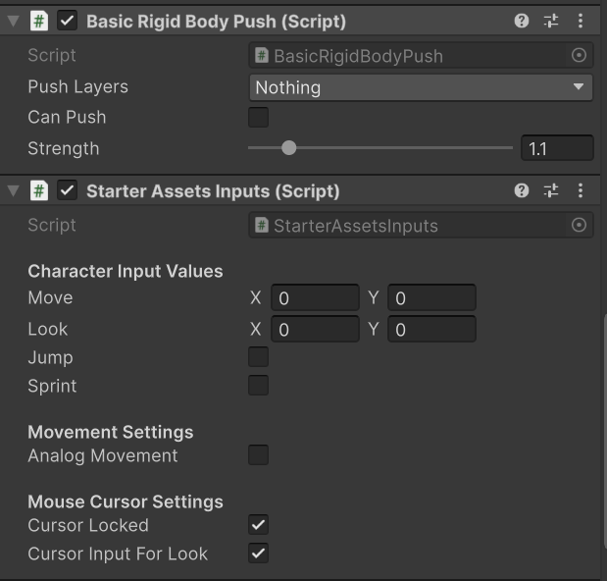
Import Standard Assets
Basic Rigidbody Push Script
It doesn’t do anything atm
But as we are using a controller and this controller component doesn’t by default interact with the unity rigid body physics system
If we add a cube, add a rigidbody to it, you’d expect this character controller to be able to interact with this rigidbody, but it actually won’t.
This package gives us a custom class called Basic Rigid Body push.
Set Push layer to everything and Check Can Push to True we can see the affect when we interact with it. Now we can move things away.

Slide 21
Import Standard Assets
Starter Assets Inputs Script
This is actually how we’re going to interact with this player input action map that we took a look at previously.

Slide 22
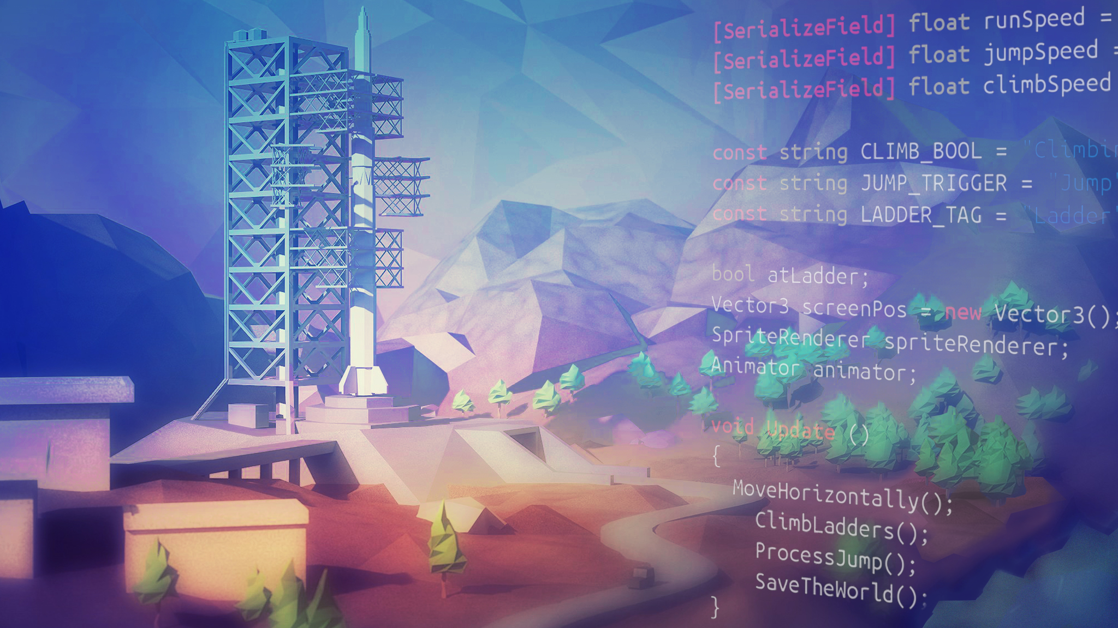
Create our own scene from the Scratch

Slide 23
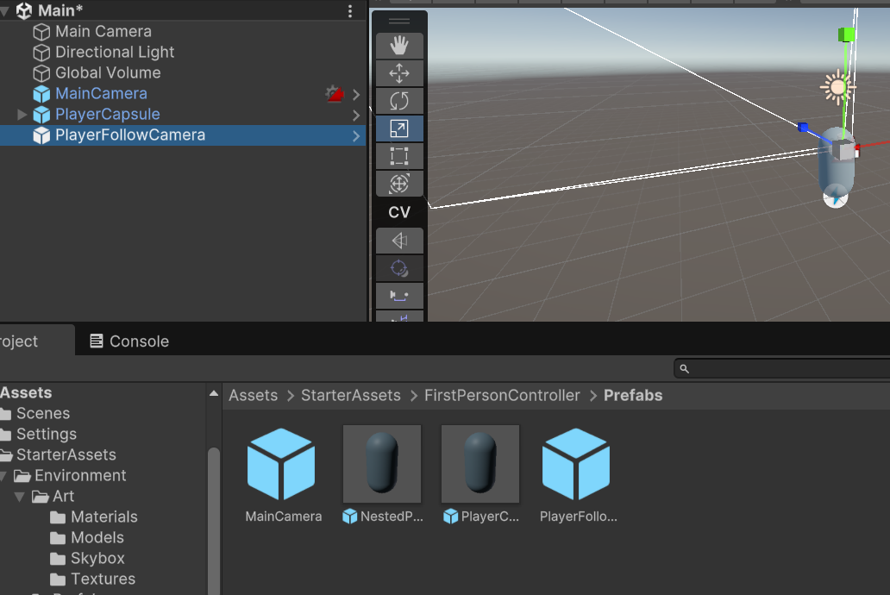
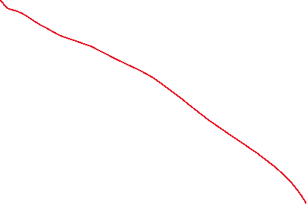
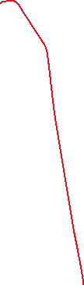

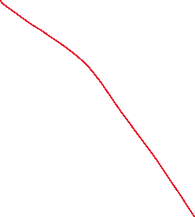
Creating the scene
Head over to Assets – Scenes
Rename the sample scene to Main and open it up
Now that we’re on our own scene, let’s get our player controller working in this scene.
Navigate to Assets → Starter Assets → FirstPersonController → Prefabs
Drag Main Camera, Player Capsule, and the Player Follow Camera to our hierarchy window.
Delete the previous Main Camera shown at the top

Slide 24
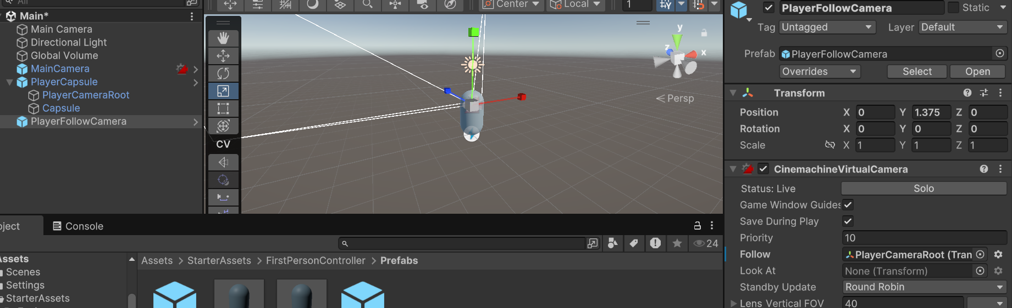
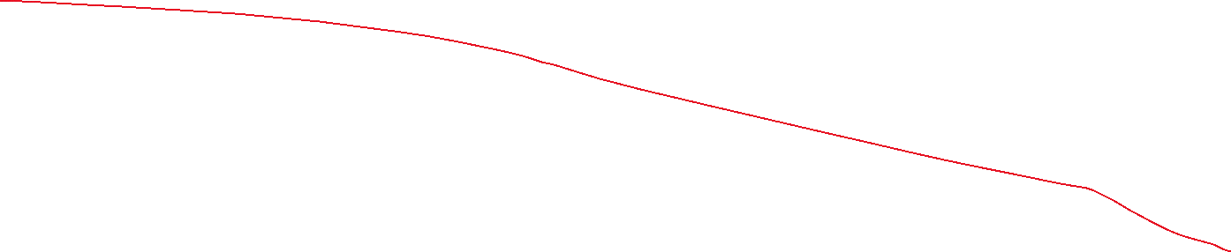
Creating the scene
Make sure that we actually open up our player capsule in our hierarchy.
Click on the PlayerFollowCamera and assign this playerCameraRoot to our PlayerFollowCamera’s Follow section.

Slide 25
Creating the scene
Add a cube as a ground, reset transform and scale it up x=50,y=1,z=50
Also make the player’s y=0.5 to bring it above the ground.
Click Play and test the game.

Slide 26
NavMesh Agent

Slide 27
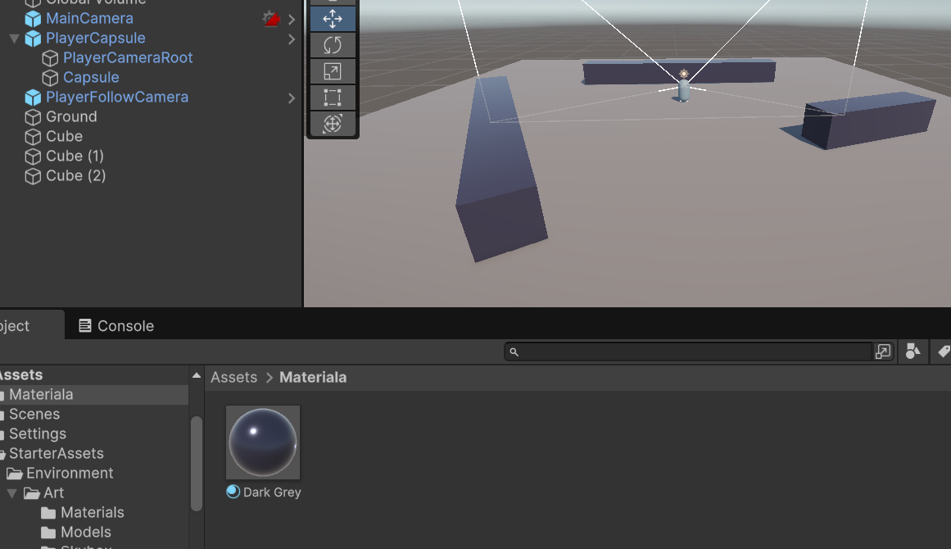
NavMesh Agent
At this level we don’t have anything yet, so let’s actually just set up a few temporary cubes scattered around our scene, not only to help our player have a little bit of depth walking around, but to give ourselves a few obstacles for our soon to be navmesh agent.
Add some cubes in the scene and scatter them around in our scene with some different shapes. Also add some different colors to these cubes.
Notes:
The NavMesh Agent in Unity is a component used to enable GameObjects to navigate through a scene using Unity's Navigation System. It works with the NavMesh (Navigation Mesh) and handles pathfinding, obstacle avoidance, and movement along predefined walkable areas.

Slide 28
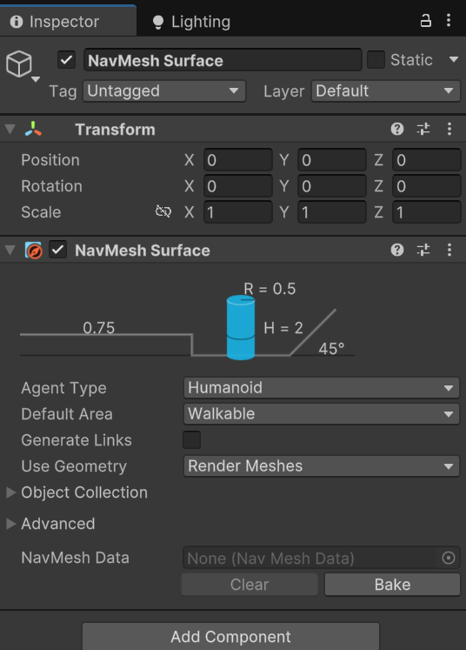
NavMesh Agent
These obstacles will help us to visualize our position in the scene
It will also actually be beneficial for setting up a navmesh surface and having a little bit more clarity in what that looks like here in our hierarchy.
Create an empty game object in our Hierarchy called “Nav Mesh Surface”
Add a component “NavMeshSurface”
This component is going to be able to tell Navmesh agents where they can actually walk.
Navmesh surface, need to take in an agent type.

Slide 29
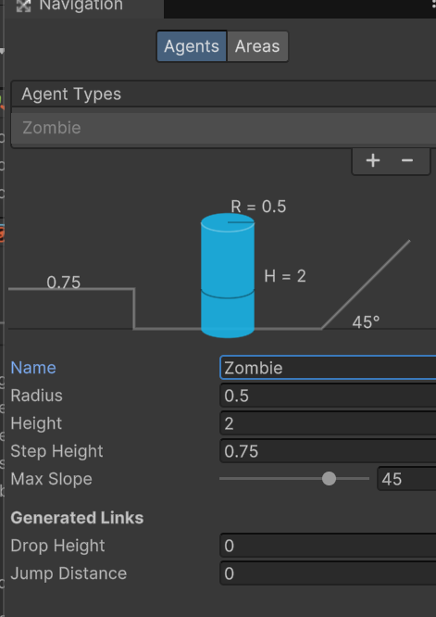
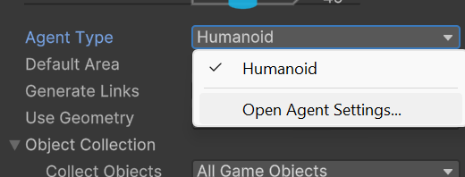
NavMesh Agent
Click on the Agent Type → Open Agent Settings
And rename the Agent to Zombie as we’ll add zombies later into the scene.

Slide 30
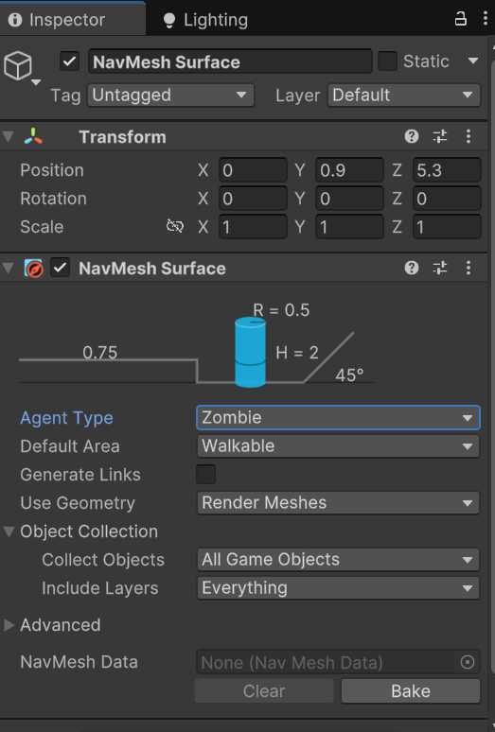
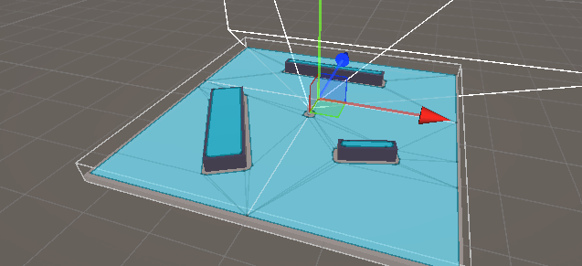
NavMesh Agent
Down below you can see the button Bake
Click the Bake button and we now have our first Navmesh surface.
It created this navmesh surface based on this agent type agent settings.
If you zoom in a little bit around where this navmesh is and change the radius e.g 2 and bake it.
It’s going to actually shrink where this zombie could nagivate to.
Shrink our radius back to 0.5 and bake
Notes:
What is the Agent Type's Radius?
The Radius in the Agent Type Settings specifies the size of the agent’s collision boundary for navigation purposes.
It defines how close the agent can approach walls, obstacles, or other agents.
A larger radius requires wider paths, while a smaller radius allows the agent to fit through tighter spaces.

Slide 31
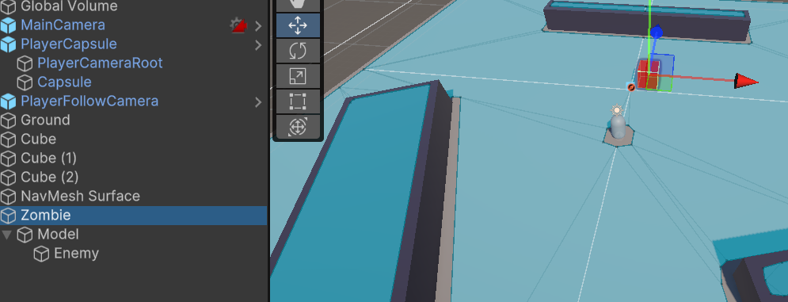
NavMesh Agent
Lets create our first enermy.
Create a new 3d cube and give it a color.
Create an empty game object “Model” and drag the enemy under it
Create another emptygame object “Zombie” and drag Model under it
On this Zombie we want to attach our Navmesh agent.
Notes:
Select game object you want to get a parent object for and hit Ctrl+Shift+G

Slide 32
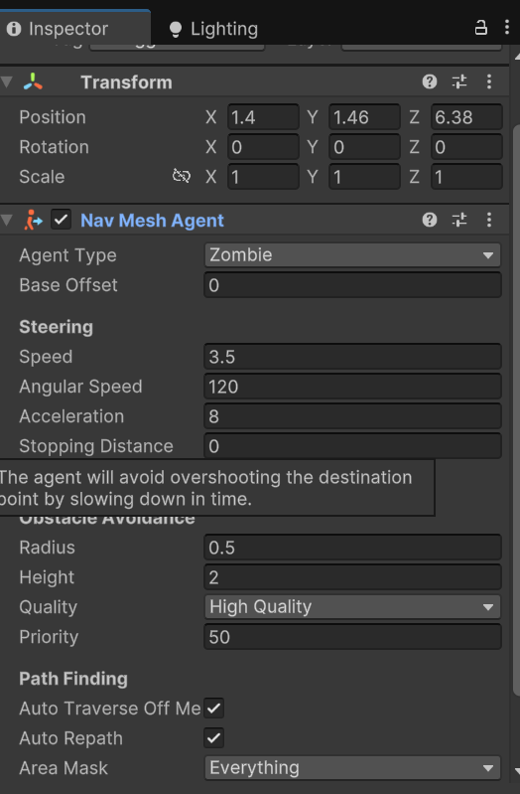
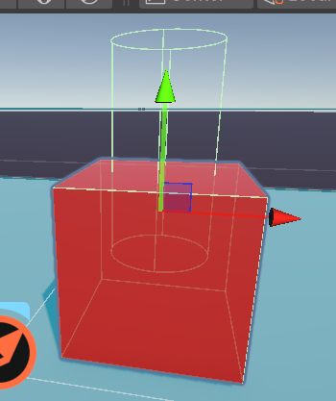
NavMesh Agent
On this Zombie we want to attach our Navmesh agent.
We can see that our Navmesh agent isn’t properly set yet.

Slide 33
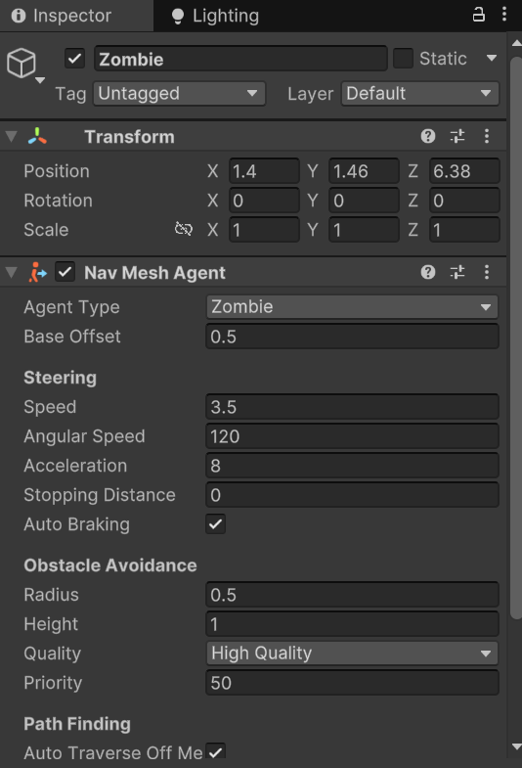
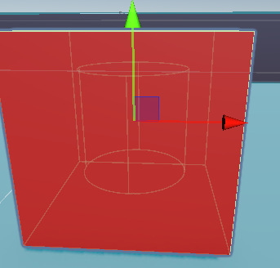


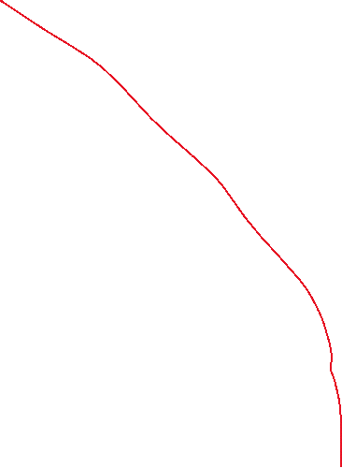
NavMesh Agent
Our cube is actually 1,1,1
Let’s change our height on our obstacle avoidance to 1
Base offset = 0.5
Now we have our navmesh agent directly lined up with this cube.
Notes:
The Base Offset property of a NavMesh Agent in Unity defines the vertical offset of the agent from the center of its GameObject.

Slide 34
NavMesh Agent
Click on the cube and delete the box collider component entirely.
The navmesh agent will actually handle things like collision for us.
Now we need to tell our navmesh agent where to go.
Create a new script “Zombie” and attach it to our Zombie game object.

Slide 35
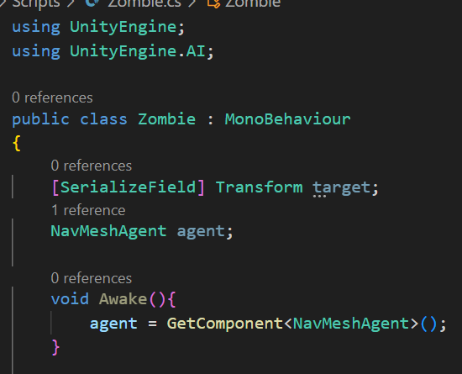
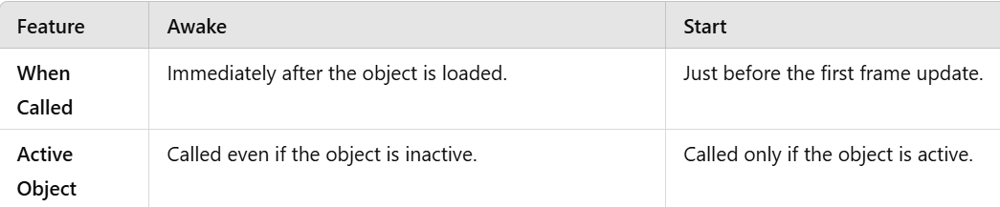
NavMesh Agent
Grab a navmesh agent component
And assign it in the Awake method
Also create a serialized field as a transform for a target that we can actually assign in our Inspector, and we can just call that “target”. i.e player.
Notes:
Awake Executes before all other lifecycle methods (e.g., Start, Update) and before any scene rendering.

Slide 36
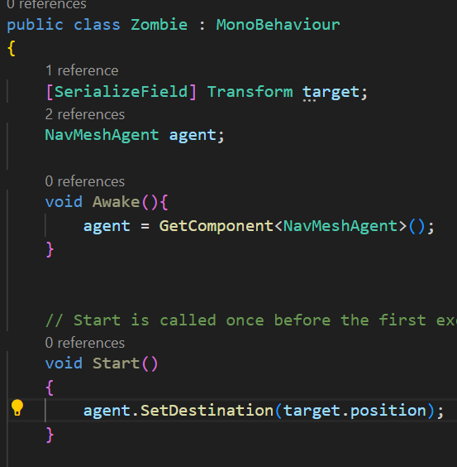
NavMesh Agent
All we want to do now is actually set the destination for our agents to move, using the built in Navmesh unity method called SetDestination.
All it takes in a vector3 for where we actually want to move our agent.

Slide 37
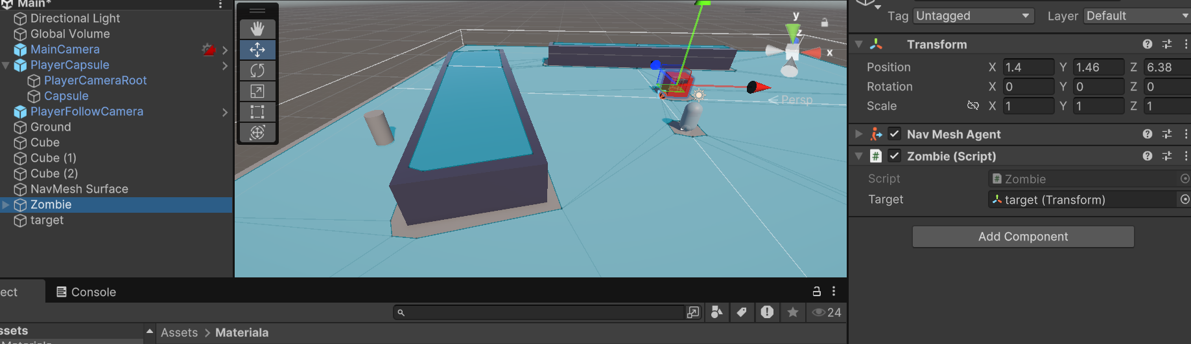

NavMesh Agent
Head back to unity and give this a try
Create a 3d object cylinder as a target.
Snap it down back behind the obstacle
Click Zombie and assign the target to this cylinder we just dropped.
Notes:
Use Ctrl+Shift and click in middle of the 3d object to move it on the surface

Slide 38
Challenge – Chase the Player
Instead of our robot moving towards our target target transform, have it chase our Player Capsule.
Also move agent.setdestination from start to update, so it actually updates every single frame, and you’ll need some sort of reference to our player.

Slide 39
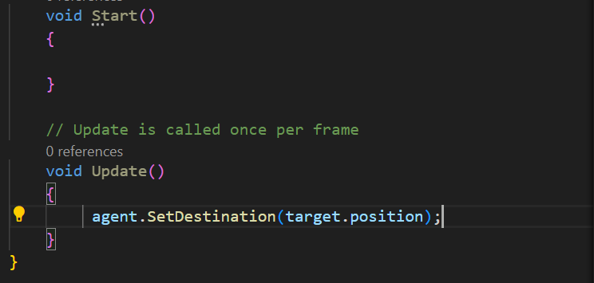
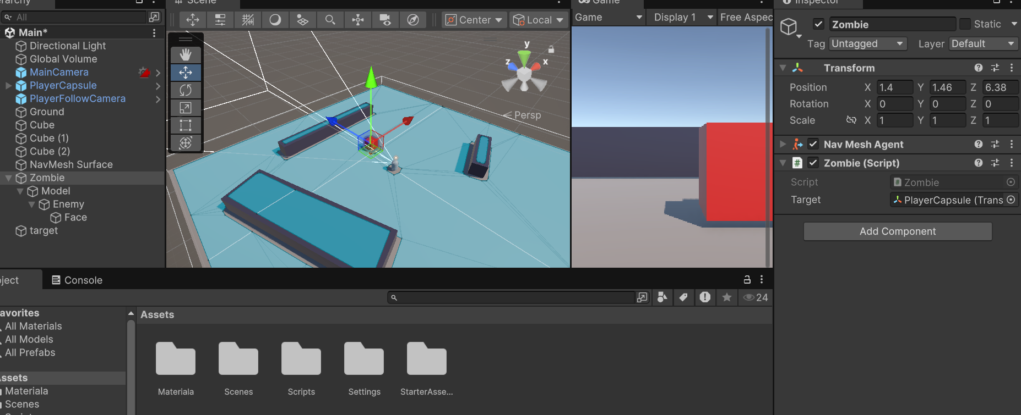


Chase the Player

Slide 40
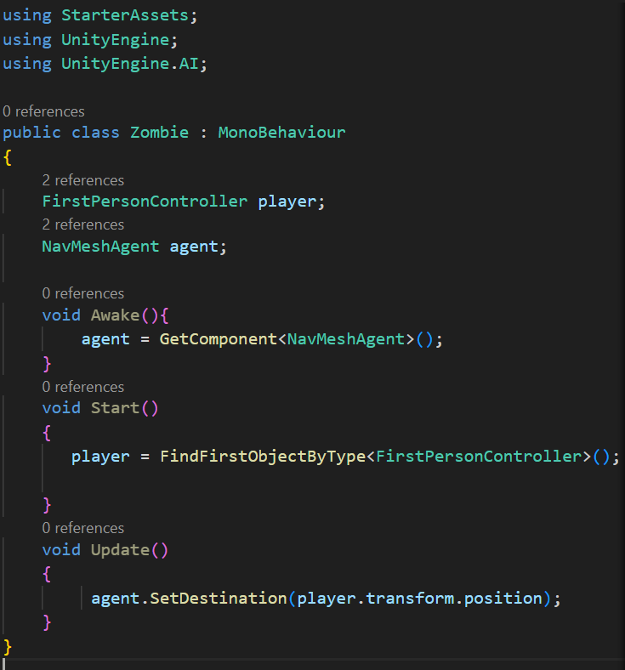
Chase the Player
We’ll do this with another way to avoid serializefield
We’ll just use the type FirstPersonController class that actually came with the assets we imported and name it Player.
Assign it in the Start method using FindFirstObjectByType<>()

Slide 41
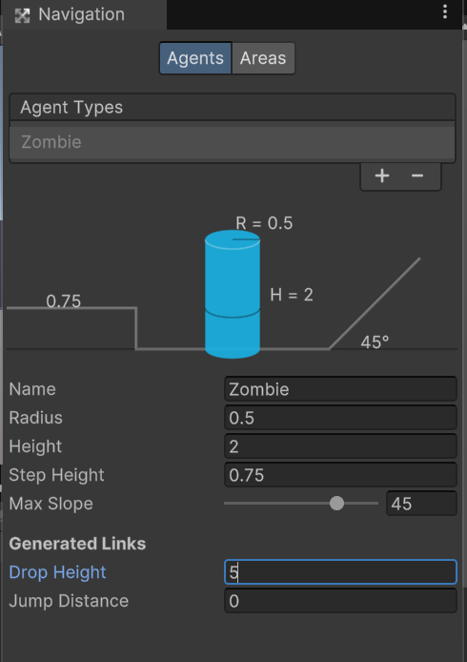
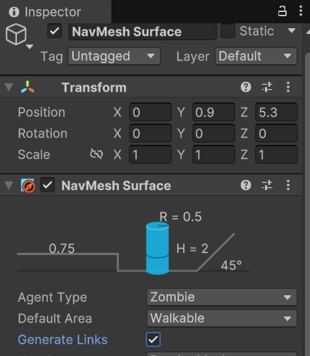


Agent Jump and drop height
As we know currently, our zombie isn’t able to jump to any surface and also drop from it to the ground
We can do that in Nevmesh Surface’s Agent setting. If you set drop height to 5 and bake it
You won’t see anything in the scene view yet because we need to toggle on this Generate Links in the Nav Mesh Surface Inspector window.

Slide 42
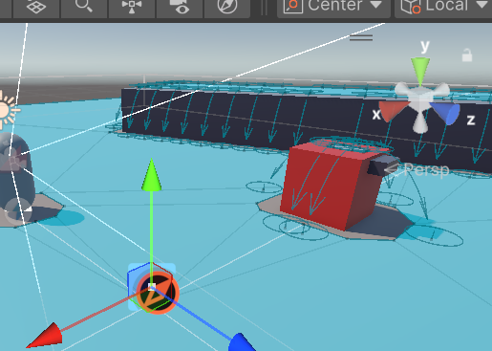
Agent Jump and drop height
We can see that our zombie can actually drop down but can’t jump up or jump down.
Being able to jump up or down uses a different Navmesh component called Navmesh link.

Slide 43
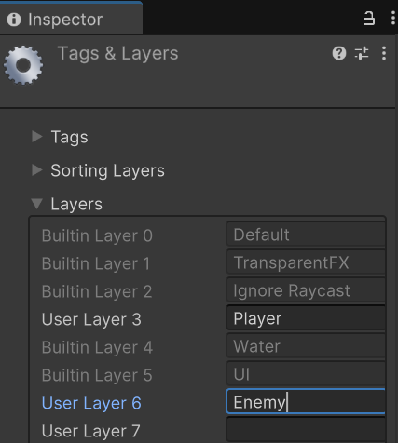
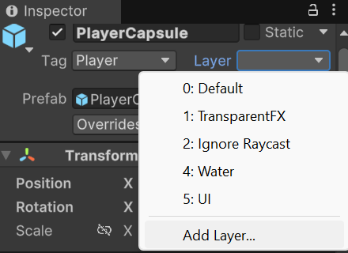
Layers
We notice that the area where enemy and player is placed initially, it is not part of the navmesh surface and blocked out.
Lets create both an enemy layer and a player layer, so we can actually use those later on as well.
Go to our PlayerCapsule and add a player layer.
Notes:
In Unity, Layers are a powerful feature that helps you organize, manage, and control how different GameObjects interact with rendering, physics, and other systems. Layers are essentially categories you assign to GameObjects for easier management.

Slide 44
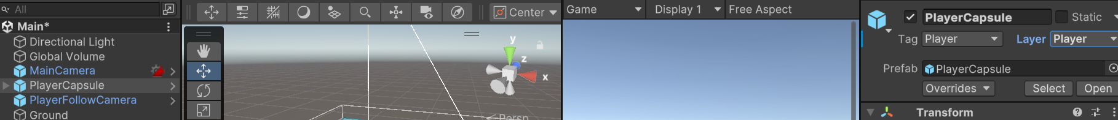
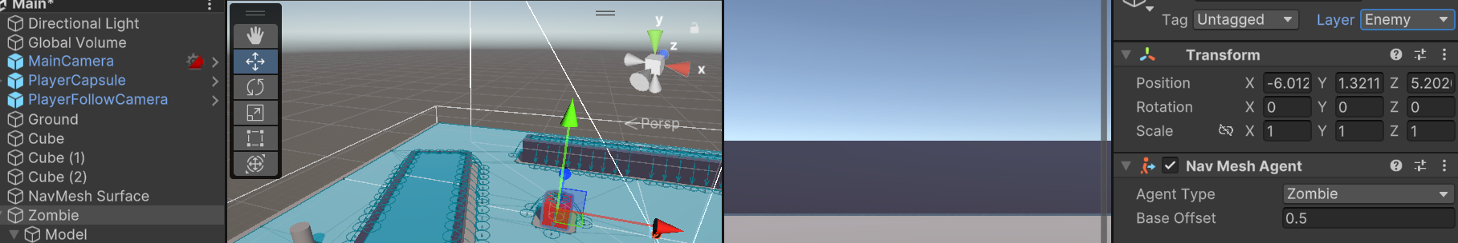

Layers
Now assign PlayerCapsule layer as Player
Now assign Zombie’s layer as Enemy

Slide 45
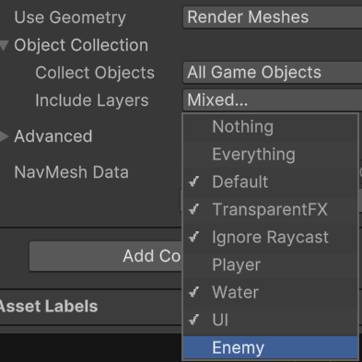
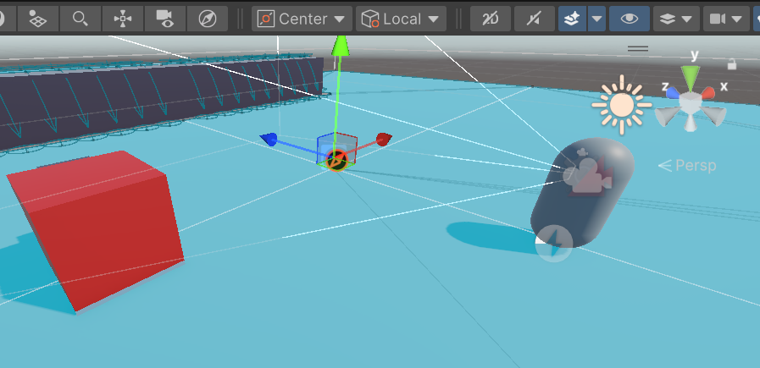
Navmesh agent
Now we can actually go back to our navmesh surface inspector window. Find out the Include layers under the Object Collection
Toggle off enemy and player from everything
Hit bake and now you can see enemy and player’s are not blocking the navmesh surface.

Slide 46
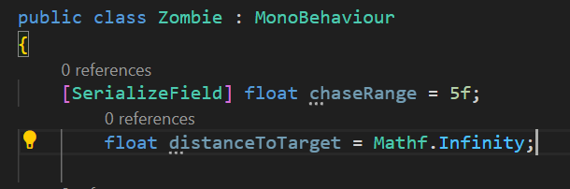
Enemy Chase Range
We’ll create a concept of range, so if the player gets close enough to the enemy, the enemy says “Aha! There’s something I should go and destroy”.
But if the player’s all the way over the other side of the map, then the enemy doesn’t chase.
Jump over to our Zombie script, Create a serializefield of type float called chaseRange
Create another float var distanceToTarget, don’t serialize it because we don’t need to access to this to create a concept that how far is the enemy to whoever we’ve identified is going to be the target and we’ll initialize it with infinity.
If we don’t initialize it. It will be 0 and enemy will think that target is very closer and start following it.

Slide 47
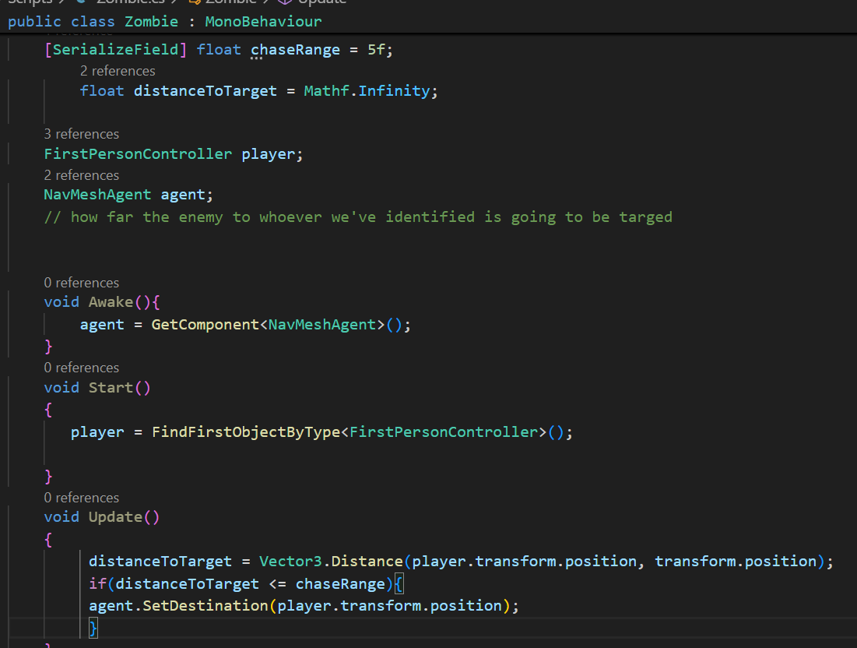
Enemy Chase Range
In the update, we’ll create a concept that
What is the distance to target?
It’s gonna be vector3.Distance(target’s position, our position)
When should we actually run at the player?
Add an if statement to make our enemy move if the player gets within range

Slide 48
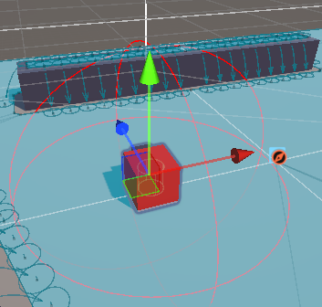
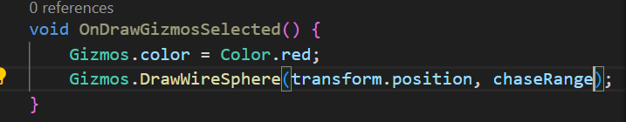
OnDrawGizmosSelected()
We are going to create a visual representation so that we can see what the range of the enemy is.
If we are in that range, it starts coming to us.
It makes it easier to test, tune and design of our game.
Draw a Gizmo for chase range
- When the enemy is selected, we draw a wire sphere to show chase range

Slide 49
Enemy AI – Attack if provoked
We’re going to create some more enemy behavior where the enemy once provoked, chases the player and keeps chasing until it gets close enough to attack. For now, we’ll print something in the console saying “Zombie attacking etc.”

Slide 50
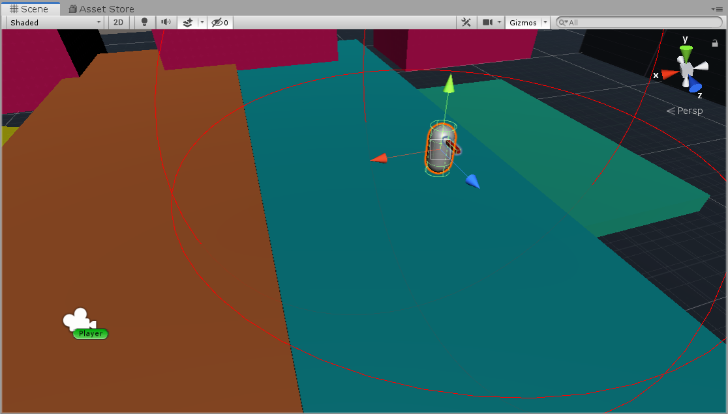
Enemy Behaviour - Provoked
“EXTERMINATE!”
Shot
Is Visible (ie. player got within range)
Notes:
Enemy would be provoked if the player is visible.
Or in future when player shoots at the enemy, We want the enemy to be like, I’m going to get that guy and exterminate.
And we’ll add an idea that once the enemy is provoked, he stays provoked.

Slide 51
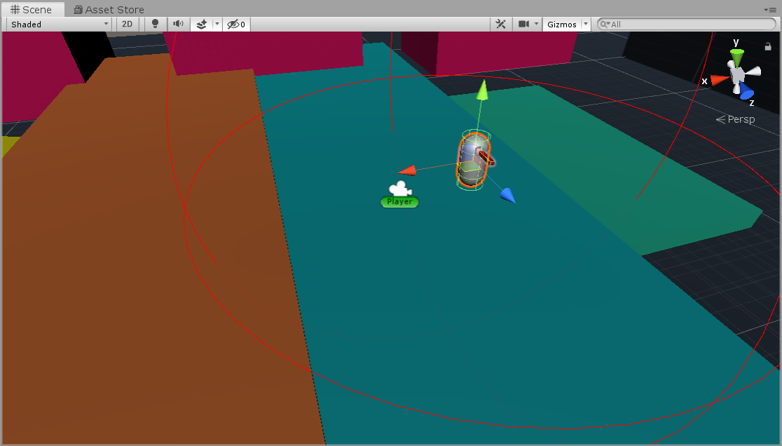
Enemy Behaviour - Once Provoked
Shot
Attack if close enough
Is Visible (ie. player got within range)
Otherwise, chase
Notes:
We’ll use the nav mesh stopping distance to say when you’re close enough, Attack.

Slide 52
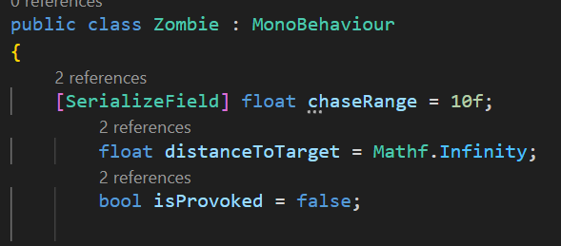
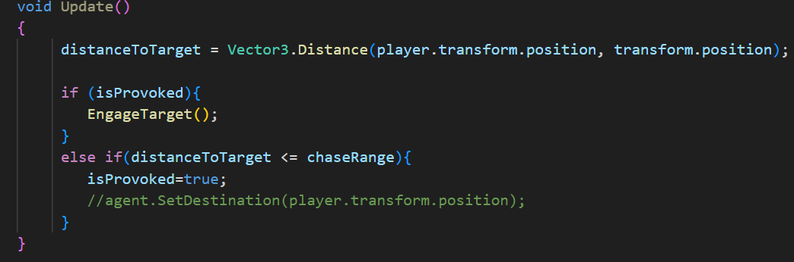

Enemy AI – Attack if provoked
Create a bool isProvoked
In Update, check if provoked or not. Create a method EnagageTarget() and call if it is provoked.
In the EngageTarget if something happens ChaseTarget() – move to target and if something happens AttackTargget – print “Attacking”
Notes:
Later, we’ll add different conditions for Provoke
For example, if the enemy hears us shooting off in the distance, or if there’s an alarm sound etc.

Slide 53

Enemy AI – Attack if provoked

Slide 54

Importing the assets
We’ll import some assets and place a gun in our player’s hands.
Also re-organize our Hierarchy
Create an empty game object “Environment” and drag all of our cubes and navmesh surface.

Slide 55

Adding a robot
For now, we’ll replace zombie with a robot, later on we’ll change it to zombie when we load zombie asset into our scene
Open our Zombie game object, open model and delete all game objects.
Drag and drop the robot under the model and go to texture folder to fix the materials.

Slide 56





Adding a robot

Slide 57

Equip the Gun
Inside the model's folder, we can actually find this kinetic weapons folder where we’ve got three different weapons that we’ll use in this game.
Import the pistol gun model into your project and child it to your PlayerCameraRoot under your PlayerCapsule.
Add a gun reticle image to an Overlay Canvas in our scene Hierarchy.

Slide 58

Equip the Gun
Create an empty game object “Pistol” as a child of PlayerCameraRoot

Slide 59



Equip the Gun
Create an empty game object “Pistol” as a child of PlayerCameraRoot
Create another empty game object “Model”
Drag the pistol asset under this Model

Slide 60

Equip the Gun
Click on Pistol and then we just want to properly scale this or rotate it more specifically to be properly situated on our game view camera.

Slide 61

Equip the Gun
Go to our player follow camera in our cinemachine virtual camera, and adjust near clip plane under the Lens if necessary.

Slide 62

Equip the Gun
Set up our overlay canvas in our Hierarchy.
RightClick and create Canvas.
Rename it Overlay Canvas
Change UI scale mode to Scale with Screen Size.
Reference Resolution to 1920x1080
Notes:
Event system – is used with clicking things like buttons in the canvas.

Slide 63




Equip the Gun
Right click on Canvas Overlay →UI→ Image .. Rename image to Crosshair.
Navigate to Gdtv assets and drop the crosshair into the source image.

Slide 64


Removing the shadows on Pistol
Click capsule in hierarchy and under the Lighting – Turn off cast shadows

Slide 65

Removing the shadows on Pistol
Click capsule in hierarchy and under the Lighting – Turn off cast shadows

Slide 66
Raycasting
We’ll start the process of shooting our gun using a raycast.
At the moment when we’re walking around our game, we need some sort of way to be able to actually get the direction we’re aiming and then more specifically, actually get what we’re hitting.
We need some sort of ray to actually shoot from basically the center of our screen (basically our camera) to where we’re actually looking with our crosshair.

Slide 67

What Is Raycasting?
Raycasting is the process of shooting an invisible ray from a point, in a specified direction, to detect whether any colliders lay in the path of the ray.
Location
(x, y, z)
Direction
Origin
Ray
Collision
(RaycastHit)

Slide 68
Raycasting
Raycasting in Unity is a powerful technique used to detect objects along a straight line or ray. It’s commonly used in game development for tasks like detecting obstacles, selecting objects with a mouse click, checking line of sight, and more.
How Raycasting Works
A ray is projected from a point in a specific direction.
The system checks for collisions along the ray.
If the ray intersects with any colliders, it provides information about the hit, such as the object hit, its position, and its distance from the origin.
Key Components
Origin: The starting point of the ray.
Direction: The direction in which the ray travels.
Distance: The length of the ray (optional; infinite if not specified).

Slide 69
C# Out Keyword
The out keyword in C# can be used as a parameter modifier, which lets you pass an argument to a method by reference rather than by value.
Normally, a method returns just one value (like a number or a string), by using out, you can send multiple values back to the caller.

Slide 70
C# Out Keyword
We need to declare the variable before we use it, and then we can actually pass through that variable and return a value, setting that value to what we actually already passed through as a parameter.
RaycastHit hit;
If(Physics.Raycast(origin, direction, out hit, maxDistance)
{
// do something
}
Notes:
https://docs.unity3d.com/ScriptReference/Physics.Raycast.html

Slide 71


Raycasting
Head back to unity and create a new script called Weapon and attach it to our Pistol.
Now we really only ever want to fire a ray when we’re actually firing our gun on left click, but let’s hold off on input for just a second and actually just fire off a ray inside of update.
Physics.Raycast(Camera.main.transform.position, Camera.main.transform.forward, out hit, Mathf.Infinity);

Slide 72

Raycasting
If we go back to Unity, and see that our robot doesn’t have any collider. Navmesh agent will work as a collider for some things (obstacle avoidance, rigidbody collisions etc.) but not recessarily a raycast.
If we want to hit the zombie itself, then we need to add a capsule collider on it.

Slide 73

Raycasting
When we play, we can see it works for almost every object
But if we move our crosshair towards sky it gives us an error. Not hitting any collider because there isn’t any collider on the sky.
Inside the script, return the Debug.log if we are only hitting some collider.
Click Robot, navigate to our Navmesh agent, Change our stopping distance to 2 units, just to make sure that robot doesn’t come too near to our player.

Slide 74

Raycasting
Everything into the if condition

Slide 75


Raycasting
Before we move on, fix up these little artifacts that we’re getting in our shadows.
Go to our Settings inside the assets folder → PC_RPAsset
Scroll to shadows property and change Depth Bias and Normal Bias to 0.
Notes:
Depth Bias offsets shadow depth values to reduce shadow acne caused by precision issues. Normal Bias shifts shadow sampling along surface normals to prevent floating shadows (Peter Panning).

Slide 76

Shoot Input
Now we’ll modify the starter assets input system and get our gun only firing when we actually click the left mouse button.
On left click, the easiest way to really set or rig that up is actually modifying this starter asset Input system action map that already exists.

Slide 77

Shoot Input
We need to just set up a new action for shoot.
Create a new action by clicking on Plus “Shoot”
Set our Binding for Mouse Click
After completion, Click on Save Asset.

Slide 78




Shoot Input
Navigate back to our Player Capsule, Inside the inspector if we scroll down we just need to actually find this player input component. We can see here that it’s opting to use the behavior “send messages”, meaning that we actually just created a new behavior on shoot.
And we can use this on shoot method to directly hook into using this starter assets input scripts.
Open this Starter Assets Inputs scripts to see how does it look.

Slide 79





Shoot Input
#if #endif block is a little bit different from standard C# if block
This is basically just able to say directly anywhere inside of this script, but not necessarily inside of a class.
If we’re using things like the unity engine input system, you can actually block out an entire section of a script and say if enable input system, then only actually go ahead and compute all of this logic.

Slide 80

Shoot Input
Create a bool shoot at top so we can access it in another classes as wel.
Like any other methods we have in the script we can
Create a publc void OnShoot(InputValue value)
{
ShootInput(value.isPressed);
}
Void ShootInput(bool newShootState){
shoot = newShootState;
}

Slide 81


Shoot Input
Create a void OnShoot(InputValue value)
{
ShootInput(value.isPressed);
}
Void ShootInput(bool newShootState){
shoot = newShootState;
}

Slide 82





Shoot Input - Summary
We started out by creating a new action in our action map called shoot.
This action is going to cast out a behavior method called OnShoot.
Every single time our left mouse button clicks down.
When that happens, it’s going to actually go through on this input system itself, “the player input” in our case. And its going to cast out that OnShoot method to any script attached to this GameObject.
And in that script we just created OnShoot behavior method.

Slide 83
Shoot Input - Summary
When this method is fired, its going to actually get the input of the binding that we set on this action. In our case, the left click mouse button.
That’s going to pass through whether the value is pressed or not.
In our case it will always pass True into our Shoot input method.
Its going to set out global bool shoot to true (the state we just got.)

Slide 84

Shoot Input
Navigate to our Weapon script
Grab a reference to our StarterAssetsInput class
And assign it in Awake

Slide 85

Shoot Input
Now in update, we only want to fire this raycast if we’re shooting.
We can say if starterAssetsInput.shoot is true then shoot.

Slide 86


Shoot Input
If we head back to Unity and check that on left mouse button click we can actually shoot but even if we stop shooting, In the inspector window shoot bool is still set to true. So we need to toggle it back to false.

Slide 87

Shoot Input
Head back to our weapon class and set Shoot to false.

Slide 88
Enemy Health
We’ll try to blow up our robot if it takes three damage from our pistol.
We’ll introduce enemy health class and then attaching that to our enemy.
Challenge
Destroy the robot when it take three shots from our pistol.
Create an EmenyHealth script for the robot
Create an int for both starting and current health.
Create a public TakeDamage() method we can use in our Weapon class and destroy the robot if it loses all it’s health.

Slide 89

Enemy Health
Add a serialized int variable startingHealth to define the initial health of the enemy
currentHealth var to know the currentHealth value of total startingHealth.

Slide 90


Enemy Health
In the weapon script, call the TakeDamage
Delete the debug.log and check if whatever we hit has an enemy health type or an enemy health type component.
We can just go and grab the enemyhealth and assign it with hit.collider.GetComponent<EnemyHealth>() to check whether the hit object has an EnemyHealth component attached to it.
We can check if it is not null than call TakeDamage and pass damageAmount.

Slide 91

Clean up our code – Weapon script
We can simply return if it is not shooting
We can use null conditional operator instead of if (enemyhealth) codea
enemyHealth?.TakeDamage(damageAmount);
Using this ? Syntax is null conditional operator.
Its basically saying Does enemyHealth exist? If it does, then take damage.

Slide 92

Clean up our code – Weapon script
As everything is in the Update method, select everything inside the Update method and extract a new method “HandleShoot”

Slide 93

Clean up our code – Weapon script
As everything is in the Update method, select everything inside the Update method and extract a new method “HandleShoot”
Notes:
Prefab our robot to create multiple ones in the scene.

Slide 94

Muzzle Flash
We’ll go to the assetstore to get some assets that we’ll use.
https://assetstore.unity.com/packages/vfx/particles/simple-fx-cartoon-particles-67834
Download and import them into your project.
Create a new folder “Imported Assets” in the Project window. Place all imported assets’ folders in it so we can keep track of things.
Notes:
A muzzle flash is a visual effect used in games to simulate the bright burst of light emitted when a gun is fired

Slide 95

Muzzle Flash
In the assets we just imported; we can see that these 4 materials are not properly loaded.
Select all these 4, Click on Edit → Rendering → Materials →
Convert Selected Built-in Materials to URP
Notes:
URP stands for Universal Render Pipeline in Unity. It is a scriptable rendering pipeline designed to provide optimized graphics performance and flexibility across a wide range of platforms, from mobile to high-end PCs and consoles.

Slide 96


Muzzle Flash
We’ll use this Fireworks Yellow small one for our muzzle flash
Hit Ctrl+C to copy this entire game object and head back to our original Main Scene.
Press Ctrl+V in the Hierarchy
Child this fireworks particle to the pistol itself.
Unpack this prefab. That way the prefab itself from Sentai Studios stays the same.
Rename this to our Muzzle Flash and drop it into our Prefab folder.
Reset the position to 0,0,0 in transform
Turn off the capsule and all your gizmos to place the fireworks particle infront of the pistol, where you want it to be.

Slide 97



Muzzle Flash
Particles are too big, lets fix it
Change the Scaling Mode to Hierarchy. If we don’t do that it actually won’t scale when we modify these transform properties.
Change it to 0.05
Change the shape from sphere to cone.
Change the cone’s direction towards forward.
Reduce the Bursts count to 30 Under the Emission.
Change the color if you want to.
Change the start Lifetime

Slide 98




Muzzle Flash
TO make a glowy affect
Make sure Post processing on MainCamera is enabled.
Navigate to rendering in the Muzzle Flash inspector.
Navigate to the Assets/ImportedAssets/SimpleFX/Materials and drop the FX_GunFlash to the Material of Muzzle Flash
Notes:
If we double click the material and set base map to yellow. Emission to yellow and increase the intensity. It will create a glowy affect show in the image above.

Slide 99



Muzzle Flash
Open Weapon class and set up the particle system. And play when we shoot.
Untick Play on Awake in unity
Go to Pistol and assign our muzzle flash to it.

Slide 100

Terminology
Animator Component: Assigns animations to GameObjects through an Animator Controller
Animator Controller: Arrangement of animations and transitions (state machine).
Animation:
Specific pieces of motion
Transition:
Rules to move from one state to another

Slide 101

Weapon Animation
We’ll create a simple kickback animation for our weapon.
Navigate to Window → Animation → Animator
Animator Window
Visual tool to manage and connect animations using a state machine.

Slide 102

Weapon Animation
Also open Animation window
Notes:
Animation Window
Used to create, edit, and preview keyframe animations for objects

Slide 103
Weapon Animation
Lets actually create a custom kickback animation for our pistol in our project window.
In our Project window, in ou assets folder, create a new folder Animations.
Inside that create a new folder called Weapon
We’re going to need an animator to actually control the state of the animations that we’re using.
And couple of different animations, one for when we’re just kind of idling, basically not doing anything.
And then another one for when we’re actually shotting our gun.
Create those inside of our weapon folder

Slide 104


Weapon Animation
Inside the weapon folder, Right click → Create → Animation → Animation controller
Rename it to Weapon
Notes:
Animator Controller
Asset that organizes and controls animation transitions and states.

Slide 105

Weapon Animation
Create an animator component that we can attach this to.
As we’ll use this same kind of animation for all of our other weapons – just a basic kickback motion. So, we’ll refactor a little bit in our hierarchy.
Select Pistol and create a parent GameObject of Pistol and call it “Active Weapon”. We’lll actually create the animator component directly on this Active Weapon Game object. So we can animate this active weapon gameobject directly and it will go ahead and visually animate everything below it as well.
Notes:
Animator Component
Component on a GameObject that links the Animator Controller to play animations.

Slide 106

Weapon Animation
In the inspector window of Active Weapon, add an Animator component.

Slide 107



Weapon Animation
Drop in the Weapon Controller

Slide 108

Weapon Animation
Once my Active Weapon in hierarchy is selected we can navigate to our Animator window and see what animation states I’m using inside of this animator attached to this GameObject.

Slide 109


Weapon Animation
Lets create a couple of animations that we can use.
In our Project window, inside of our Weapon folder.
Right Click → Create → Animation → Animation Clip
Call it idle
And create another animation clip “Shoot”
Notes:
Animation Clip: A file that stores keyframe-based motion data.

Slide 110

Weapon Animation
Drop the idle animation first in animator window
The animation you drag in first will be the one that actually has this default transition line signified by this orange color.
Drag in shoot animation too.

Slide 111



Weapon Animation
You can right click on the animation clip you dropped and can make a transition
Create some sort of parameter is probably a trigger or a bool and then transition between these two.

Slide 112



Weapon Animation
But here is a shortcut for our case.
Click the transition that we just added and delete it entirely
We’ll do that trick with our code.
Open up the animation window and now with my active weapon selected, we can actually now use this drop down for the animation clip we just added.
Click on Shoot so we can record a shoot animation.

Slide 113




Weapon Animation
With Active Weapon selected over in my inspector, I can actually click this little record button on the Animation window, right click and add a key at the very beginning for both my position and my rotation.

Slide 114




Weapon Animation
Click the top little keyframe, It’ll highlight all of the keyframes below it.
Hit Ctrl+C to copy it.
Go over to the one second mark or the 60th frame.
If you’re not actually showing seconds and you’re showing frames instead, you can hit the little elippse drop down to change it.
Hit Ctrl+V to paste in those exact same keyframes.
Around the 20th frames or so. Lets actually create a kickback little animation. In your scene view, your rotation is set to center and and your movement mode is local.

Slide 115


Weapon Animation
As our Record button is still ON and active weapon selected. I’m just going to actually move the rotation back just a tad, and slide the entire position of the gun just back a little,
Hit the Play button to see how does it look.
If you see it’s too slow. Untoggle the Record button
Come down to the animation keyframes, hit Ctrl+A to select All of the keyframes, and then actually and shrink from the end of the keyframes to how ever snappy we want to get it.

Slide 116

Weapon Animation
Navigate to our Weapon class and create a reference to our animator (make it serializefield)
On the handle shoot, under muzzelflash playing we can call
animator.Play(“Shoot”)
Instead of directly passing the string reference we can create a const string var on top
const string SHOOT_STRING = “Shoot”;
animator.Play(SHOOT_STRING);
It would work it once but we would never be able to fire it again, because we’re never giving a chance for our animation to start over.
But we’ll pass two arguments to it as well.
animator.Play(SHOOT_STRING, 0, 0f);
Notes:
Animator.Play(string s, int i)
1st – for shoot string
2nd – Integer for the layer on which our animation resides. Animation clip we’re using is on 0 layer
3rd – Float for the normalized time upon where we want to actually start this animation. In our case its ZERO
https://docs.unity3d.com/ScriptReference/Animator.Play.html

Slide 117


Weapon Animation
Also move the starterAssetsInputs.ShootInput(false); out of our raycast if block.
Notes:
Our Weapon Script so far.

Slide 118





Weapon Animation
Select Pistol and drop the Active Weapon on the Animator field.

Slide 119

Hit VFX
We’ll set up another particle system for where our raycast intersects with other colliders.
Navigate to Imported Assets/SimpleFX/Prefabs .
Look for FX_Fireworks_Yellow_Small
Notes:
VFX – Visual Effects

Slide 120

Hit VFX
Drop it in our scene and unpack it.
Rename it VFX hit VFX
Prefab it
Start delay 0
Start life time 0.3
We’ll change its Scaling Mode from shape to hierarchy
Scale it to 0.2,0.2,0.2
Emission burst 50
Renderer to add a glow, select the material we are using, duplicate it, drag it to our personal material folder and change it according to your choice and add it to renderer for reference.
Make sure in the inspector of that particle – Color over lifetime is also a color that you want
Apply all changes to the prefab too
Delete it from our hierarchy and now we want it to instantiate where we are colliding with something
Open up our Weapon class.
Notes:
Change the Start delay of Muzzle flash to 0 as well.

Slide 121

Hit VFX
At top create a serializefield for hitVFXPrefab of type GameObject.
Instantiate our hitVFXPrefab particle system where our raycast collides with a collider using hit.point.
Hit.point will return a vector3.
Unity's method for creating instances of objects at runtime.
Instantiate(prefab, position, rotation);
Instantiation means creating a new instance of an object in the game at runtime. In Unity, this is done using the Instantiate() method. For example:
When you need to spawn enemies, bullets, or effects dynamically.
You take a pre-configured Prefab (template object) and "instantiate" it to create a copy in the scene

Slide 122

Hit VFX
Quaternion.identity Represents no rotation (default orientation) when instantiating objects.
hit.point A property of RaycastHit that gives the exact position where the ray intersects a collider.

Slide 123




Hit VFX
Select our pistol and drop the prefab to the Hit VFX Prefab slot.

Slide 124

Hit VFX
If we select Hit VFX prefab and navigate to the Stop Action in our inspector. We need to change it to Destroy so it gets destroy after completion of its lifecycle so we don’t have multiple instantiations of hit vfx during play mode in real time.

Slide 125
Intro to ProBuilder
ProBuilder is a Unity tool for creating, editing, and texturing 3D geometry directly within the Unity Editor. It's ideal for prototyping, level design, and creating custom meshes without needing external 3D modeling software.

Slide 126


Intro to ProBuilder
Lets import ProBuilder into our project.
Navigate to package manager → Unity Register
Search for ProBuilder and install it
We’ll see a Tools tab on top after it is installed.

Slide 127
Pro Builder

Slide 131
Introducing Animator Controller

Slide 132
Creating A Simple Animation

Slide 133
A 5 Minute Challenge
Don’t overinvest in this challenge, just 5 minutes
Create some sort of quirky animation for one of your states
Explore what else you can animate, not just Transform
Share what you come up with!

Slide 134
Animator Transition Conditions

Slide 135
Adding Conditions
Add a bool parameter called “attack”
Add conditions:
Move -> Attack when “attack” parameter is true
Attack -> Idle when “attack” parameter is false
Remember to turn off “has exit time”

Slide 136
Trigger Animation In Code

Slide 137
Set Attack Animation
Figure out where we would change our animation into attack and out of attack
Add code to set our attack state to true
Add code to set our attack state to false
Remember, attack is a bool, not a trigger

Slide 138
Use Animation Events

Slide 139
Create Player Health Class

Slide 140
Set Up Player Health
Goal: Create PlayerHealth.cs so player can lose health and print a message to console when dead.
HARD Mode: Don’t wait for hints, don’t look at EnemyHealth.cs, just dive in
MEDIUM Mode: Look at EnemyHealth.cs for hints then type out PlayerHealth.cs from scratch
EASY Mode: Copy code from EnemyHealth.cs and tweak slightly.
BONUS POINTS: Actually decrease health when hit!

Slide 141
Rotate To Face Target

Slide 142

A Vector has a magnitude and a direction.
We can subtract our position from target position.
Target Position (x, y, z)
Our Position (x, y, z)

Slide 143
If we (the enemy) is not looking at target, we want to rotate to that direction
Target Position (x, y, z)
Our Position (x, y, z)
Rotate to this direction

Slide 144
Game Over User Interface

Slide 145
Create Scene Loader
Create a public method that reloads the game
Hook this up to the Play Again button
Create a public method that quits the game
Hook this up to the Quit button
Test the Play Again button

Slide 146
Create A Death Handler

Slide 147
Call HandleDeath()
Figure out where and how to call HandleDeath() so that our Game Over logic is called.

Slide 148
Using BroadcastMessage()

Slide 149
Play With BroadcastMessage
Find another component on your enemy where you can add OnDamageTaken() method to test that our BroadcastMessage works.

Slide 150
Early Gameplay Loop

Slide 151
Do A Tuning Pass In Your Sandbox
Add more enemies
Make a “fake” goal for the player
Get from A to B
Kill all enemies
Find all the “items”
Tune Player and Enemies
Movement speed
Hit points
Damage dealt
Attack radius

Slide 152
Weapon System Overview

Slide 153
Weapon Zoom - Field Of View

Slide 154
Start Our Camera Zoom
Figure out where we can change Field Of View (FOV)
Create a reference to the relevant object that will give us access to FOV
Create 2 variables that we can adjust for zoomed in and zoomed out FOV values

Slide 155
Weapon Zoom - Mouse Sensitivity

Slide 156
Change Mouse Sensitivity
Find where we change mouse sensitivity
Create a reference to that place
Create variables with different sensitivity amounts
Change sensitivity for our 2 states - zoomed in or zoomed out

Slide 157
Basic Ammo Functionality

Slide 158
Finish Our Basic Ammo Functionality
Only shoot if we have some ammo
When we shoot, decrease the amount of ammo we have

Slide 159
Multiple Weapon Types

Slide 160
Add A Third Weapon Type
Use your own assets or tweak our carbine weapon (sorry Michael) to make a third weapon
I’ll be calling mine “pistol”
Reminder: be clear on which level of prefab your settings are stored in

Slide 161
Weapon Differentiation

Slide 162
Tune Your Weapons
Look at what tuning variables we currently have available to us
Tune your 3 weapons so that they are different to each other. What I’ll be doing:
Carbine is a sniper rifle
Pistol shoots fast but isn’t as powerful
Shotgun is slow, powerful and close range

Slide 163
Set Active Weapon

Slide 164
Player Input To Select Weapon

Slide 165
Complete Weapon Selection
Finish our code for keyboard input when selecting weapons

Slide 166
Complete Weapon Selection
Finish our code for scroll wheel input when the player scrolls in the other direction

Slide 167
Public Enum & Private Class

Slide 168

Terminology I’ll Use

Slide 169
Different Weapon Different Ammo

Slide 170
Complete Our Ammo Class
Fix our remaining methods so we can get ammo amount and reduce ammo.

Slide 171
Quick Bug Fix Challenge

Slide 172
Fix The Zoom Bug
Problem: Changing weapon while zoomed will keep the zoom for subsequent weapons
HINTS:
Hard Mode...
Go!
Not-Quite-As-Hard-Mode…
Consider using OnDisable()

Slide 173
Ammo Pickup - Part 1

Slide 174
Create The PickUp Framework
Create a simple object that we can trigger when collided with (ie. a pickup)
Add simple mesh to visualise it
Add collider
Create script with basic trigger
Ensure only player can trigger it
Print something spiffy to console
Destroy pickup

Slide 175
Ammo Pickup - Part 2

Slide 176
Let’s Add A Zombie

Slide 177
Update Enemy Death Moment
Add Die state
Transition to Die from “Any State”
Set up trigger
Trigger the animation state from your code

Slide 178
Quick Zombie Attack Challenge

Slide 179
Our Zombie No Longer Hurts Us!
Using your big brain, figure out how to make the zombie hurt us again.
Timer challenge:
Figure out the problem and implement the fix in under 5 minutes!

Slide 180
Flex Your Level Design Muscles

Slide 181

Theme:
Abandoned underground asylum.
Flow:
Find above ground entrance within a forest.
Go down stairs into the facility.
Find the trap door that leads to dungeon.

Slide 182
Design A Level
Sketch a level to use in your game
Output should be an image that we can import into our project
Level Requirements:
At least 1 branching path
At least 2 choke points
At least 1 area for a big battle with lots of enemies

Slide 183
Add Terrain & Trees

Slide 184
Add Terrain & Trees
Build out the terrain part of your level sketch (if you have one).
Add some trees and grass.

Slide 185
ProBuilder For Making Props

Slide 186
Make A Bullet Prop
Using ProBuilder, make a bullet that can be used for our Bullet pickup

Slide 187
ProBuilder To Make Rooms

Slide 188
Add A Roof
As a quick challenge, add a roof to the room we created.

Slide 189
ProBuilder To Make Levels

Slide 190
Finish Your Level
Block out all of the rooms in your level
Join together anything that needs joining
Do a fly-through to make sure it all looks fine

Slide 191
Adding Textures With ProBuilder

Slide 192
Texture Your Level
Using ProBuilder’s Material Editor, add textures to your walls and floors

Slide 193
We Need Some Lights

Slide 194
Light Your Level
Get your outdoor lighting how you want it
Place indoor lights in appropriate places

Slide 195
Create A Flashlight

Slide 196
Decay Your Flashlight
Complete our 2 methods for decaying our flashlight.

Slide 197
Create A Battery Pickup

Slide 198
Make A Battery Pickup
Create BatteryPickup.cs
Increase intensity and angle when the player picks up the pickup
Create a simple battery prop asset using ProBuilder
HINT:
You may need to use GetComponentInChildren

Slide 199
Display Current Ammo UI

Slide 200
Damage Received UI

Slide 201
Give Visual Indicator Of Damage
Find something that matches the tone of your game when player takes damage
Add the UI to a canvas that we can turn on and off
Create new script - DisplayDamage.cs
When player takes damage, enable canvas
Disable canvas again after time has elapsed.

Slide 202
Props & Polish

Slide 203
My Challenge To You
Make an incredible 5 minute experience
Use your “Player Experience” as your guide
Tune and polish your game
Add SFX for feedback and immersion
Add props to make a story
Add post-processing
Tune your pickups and enemy placement
Give the player an objective
Share with us!

